Slide 1
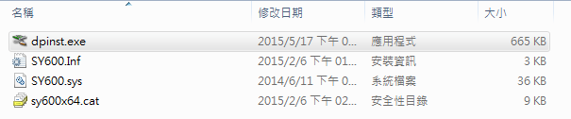
Update Firmware flow
1st please install the driver as below path(unzip the “Driver_sy600_v2.0.rar” file)
\\Driver_Sy600_v2.0\SY600_amd64\dpinst.exe

Slide 2
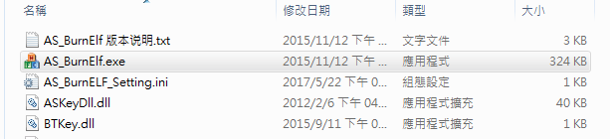
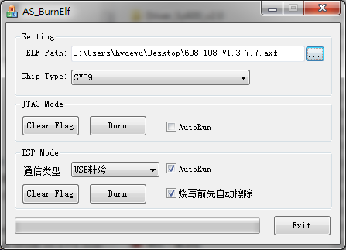
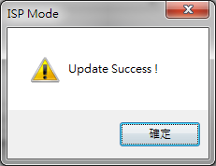
Update Firmware flow
2nd after install the driver, open the “AS_BurnElf.exe” file
And the configure as below picture
1st ELF Path choose the axf file
”608_108_v1.3.7.7.axf”
2nd Chip Type select SY09
3rd select USB, and choose these two option
4th After that , click Burn button
when it finish it will show update success
message

Slide 3
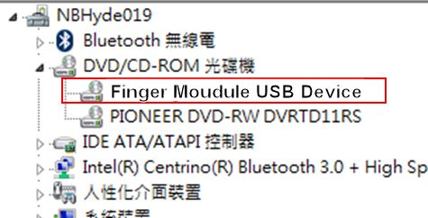
Update Firmware flow
After finish burn code, the device manager should have the device as below picture

